Slide 1
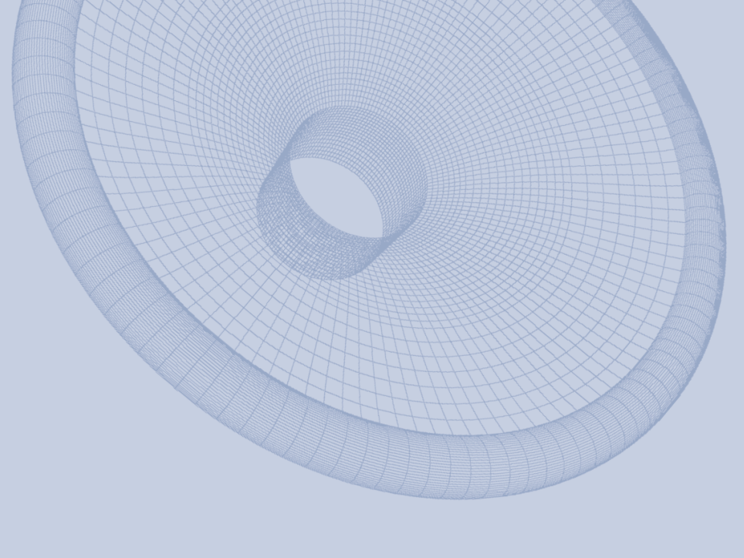

ALMA 2016:
Fast Rub and Buzz Testing
快速异音测试
Peter Larsen

Slide 2
ABSTRACT概述
An overview over traditional and up-to-date Rub and Buzz testing in the loudspeaker industry.
概括总结在扬声器行业传统和现代异音测试方法
Harmonic distortion is widely used for amplifiers, why is that not good for Rub and Buzz testing of speakers?
谐波失真的方法被广泛地应用于功率放大器的测试 ，但为什么不适合测试扬声器的异音？
Is human testing always good? What can modern Rub and Buzz methods achieve and how can they be utilized in today’s high speed production of speakers including micro speakers?
人耳听音测试是好的方法吗？最现代化先进的异音测试可以达到何种程度？这种方法是如何应用在包括微型喇叭在内的扬声器的高效生产之中？

Slide 3
Is human testing at the Assembly Line always good?组装线的人耳听音测试总是有效的吗？
  Trained operators must be more sensitive than the end user (Golden Ears) to be able to find all annoying sounds.
  为了检测出令人不快的声音经过训练的听音人员需要比最终消费者更为敏感。
  Loudspeaker SPL to be as actual application (Distance, load etc.) as it is important to test using the maximum level at the correct SPL.
  扬声器的SPL值需要和实际使用的状况如距离负载相符，使用最大的音量和正确声压级非常重要

Slide 4
Is human testing at the Assembly Line always good?组装线的人耳听音测试总是有效的吗？
  Listener fatigue of the human testers must be avoided. Take regular breaks and make sure the max SPL is limited within the law.
  需要必须避免听音员的听觉疲劳，经常性的休息和依据规范限制最大声压级在合理的范围内
  Legislation: Max 90 dBA (8 hours) Europe/USA/ -.最大90dBA计权。 This can be difficult, in practice the human testers may only work for short periods with breaks between.欧洲和美国立法规定：最大90 dBA（8小时)声压级，但在实际测试中实现起来非常困难，意味着听音员只能在间歇之间持续很短的工作时间。

Slide 5
Is human testing at the Assembly Line always good?组装线的人耳听音测试总是有效的吗？
  Testing time: One short sweep or repeated sweeps? Ideally the human testing should be the same every time.
  测试时间：采用一次还是多次测试？理想的测试每一次测试都应该得到相同的结果。
  When the tester is unsure she repeats the sweep several times. This makes the human testing non- ideal.
  当测试员无法确认结果时，可能会重复多次测试，这也是人耳听音测试不理想的原因 。
  Conclusion结论
  Human testing is slow, expensive, and not reliable!
  人耳的听音测试速度较慢，成本高且不可靠。

Slide 6
Harmonic distortion is widely used for amplifiers, why is that not good for Rub and Buzz testing of speakers?
谐波失真被广泛用于功放的测试中，为什么它不用于扬声器的异音测试？
  Harmonic distortion is defined as additional harmonics added to the (sine) wave signal. Moir [1] [2] have found very little correlation between THD / Harmonic Distortion and listener annoyance. For example adding even-order harmonics to music can sound more pleasing (like tube amplifiers).
  谐波失真是用在原始正弦信号之外产生额外的谐波来定义的。一些研究表明，THD谐波失真和令人不快的异音之间只有很低的关联度。例如在真空管放大器播放的音乐中增加偶次谐波会使声音听起来更舒服。

Slide 7
Harmonic distortion is widely used for amplifiers, why is that not good for Rub and Buzz testing of speakers?
谐波失真被广泛用于功放的测试中，为什么它不用于扬声器的异音测试？
  Steady state distortion is not representative for music, and instruments. This will appear in chapters 4.) and 5.) later.
  音乐和乐器中多出的稳态失真并不能代表什么，这一点我们将会在第4和第5章中介绍。

Slide 8
High Harmonics Testing. 高次谐波失真测试
  Ortofon in Denmark [3] found in the 1980’s that Rub & Buzz created high harmonics components, often much higher than 5th, maybe up to 15th harmonic or even higher. This was used in their successful P400 Test system.
  丹麦的奥特峰在20世纪80年代发现异音可以产生高次谐波失真，通常远高过5次甚至是15次或更高。这个理论被成功地用于他们的P400测试系统。

Slide 9
High Harmonics Testing.高次谐波失真测试
The higher harmonics correlated to indicate much of the audible Rub & Buzz, but not all. This method is therefore not suitable for replacing human testing.
高次谐波失真可以发现很多异音，但并不是全部。所以这个方法不适合替代人耳听音测试
  This principle is still used in many test systems, however with enhancements.这个原理至今还有用在许多改良过的测试系统中。

Slide 10
Human Audio perception人类声音的感知
Bosse Lincoln/Stanford University [4]:斯坦福大学的博斯.林肯^{[4]}指出：
“The human auditory system has some interesting properties. We have a dynamic frequency range from about 20 to 20000 Hz, and we hear sounds with intensity varying over many magnitudes. The hearing system may thus seem to be a very wide-range instrument, which is not altogether true.
来自人类的听觉系统有一些很有意思的特性，我们听觉的频率范围从20Hz到20000 Hz，我们听到的声音幅度变化范围也非常大。听觉系统看起来是一个有很大动态范围的设备，但实际并不是这样。

Slide 11
Human Audio perception人类的听觉感知
Bosse Lincoln/Stanford University [4]来自斯坦福大学的博世林肯:
To obtain those characteristics, the hearing is very adaptive -- what we hear depends on what kind of audio environment we are in. In the presence of a strong white noise, for example, many weaker sounds get masked and thus we cannot hear them at all. Some of these masking characteristics are due to the physical ear, and some are due to the processing in the brain”.
听觉系统有强的自适应特征。我们能听到的依赖于我们所在的声音环境。例如在一个白噪声很强的环境中，使我们根本无法听到被掩蔽的很多微小的声音。一部分掩蔽效应是由于我们的耳朵的物理特性决定的，也有部分是由于大脑处理的结果。

Slide 12
Human Audio perception人类声音的感知
Bosse Lincoln/Stanford University [4]:来自斯坦福大学的博斯.林肯^{[4]}指出：
  “Using masking principles, experiments have been performed by others where correctly shaped noise has been added to audio data without audible effect down to an SNR of 25 dB. On the other hand, deliberately “wrongly'' shaped noise, i.e. noise with high energy in sensitive areas can be audible up to an SNR of 90 dB” [4].
  应用掩蔽的原理，实验显示把某些“适当”的噪声加到声音的数据中，甚至在只有25 dB的信噪比的情况下也听不到这些噪声。相反地，人为加入一些“错误”的噪声信号,例如在人耳敏感区域包含内较高能量的噪声，这些噪声甚至在超过90 dB的信噪比时仍然可以被听到。

Slide 13
Human Audio perception人类的听觉感知
Some authorities have reported that the threshold of audible FM distortion (Frequency Modulation) is very low. Moir [1] [2] has shown that as low as 0.002% (i.e. -94 dB below the signal) is detectable when using a modulation frequency of 20 Hz and a pure tone fundamental.一
些权威报道FM（频率调制）噪声的听觉阈值非常低，摩尔^{[1, 2]}证明其小于原始信号94 dB,即0.002%的失真，采用20 Hz基频的纯音调制仍然可以被听到。

Slide 14
Danish Research丹麦的研究
  The Human brain has not changed significantly since pre-historic times. When the hunter walked in the forest and heard the sound of a tiny twig breaking at a distance, that could be an early warning of an enemy.
  人类的大脑到现在并没有发生明显的变化。当猎人在森林中行走在一定的距离听到很小的如树枝断裂的声音，就有可能是敌人的早期警示信号。

Slide 15
Danish Research丹麦的研究
  So the human audio system is strongly supported by the brain, which as a self-defense mechanism has learned to focus on extremely faint abrupt sounds. These may be very low level and containing extremely little energy, but could be strong signs of enemy activity.
  人类的大脑很强烈地支持着我们的听觉系统，这种自我保护机制使我们能聚焦于非常微弱的断裂音，虽然可能只有很低的幅度和能量，但却可能是敌人活动的非常强烈的信号。

Slide 16
Danish Research丹麦的研究
The Danish Researcher F. Leonhard [5] has invented a new method to simulate this brain activity by “processing an auditory signal to facilitate identification of abrupt energy changes within the auditory signal, which abrupt energy changes have a rise time of at the most 3 ms”.
丹麦的学者F.LEONHARD发明了一种新的方法来模拟大脑从音响信号中鉴别断续能量变化的声音，大约这种能量的上升时间最多为3 ms。

Slide 17
Danish Research丹麦的研究
  A recognized German company [6] seem to be using these principles: “High-order distortion is analyzed in the time domain … to detect even the tiniest impulses from loose particles which may be 80 dB below the main signal level”.一
  家知名的德国公司^{[6]}也在应用这个理论，在时域上分析高次谐波失真，检测到甚至是非常微小的小于主信号80 dB的松散粒子。

Slide 18
What are the requirements for QC testing in today’s high speed production of speakers, including micro speakers?
在包括微型扬声器的高速扬声器生产线，在线测试的需求是什么？
  The system must be able to find all audible Rub & Buzz, especially extremely low level Rub & Buzz components, down to -90 (-94) dB below signal.
  系统需要能发现所有可能的异音，特别是非常低的，低过信号94 dB的异音。

Slide 19
What are the requirements for QC testing in today’s high speed production of speakers, including micro speakers?
在包括微型扬声器的高速扬声器生产线，在线测试的需求是什么？
  The testing must be consistent. Therefore it should be equal to or rather better than human ear testing. (which is not really consistent, see section 1e)
  测试必须非常的稳定，因此必须要等同于或好于人耳的听音测试（虽然人耳听音试验也不可能绝对地的稳定，详见1E）

Slide 20
What are the requirements for QC testing in today’s high speed production of speakers, including micro speakers?
在包括微型扬声器的高速扬声器生产线，在线测试的需求是什么？
  Fast testing is a must. The best systems can test well in less than 0.5-1 second (including SPL with limits, Sensitivity, Polarity and impedance). However too fast testing may not excite all Rub & Buzz.
  快速测试是必须的，最好的系统可以在0.5-1秒内测试包括带公差的SPL曲线，灵敏度，极性和阻抗。但是过快测试也会不足以激发所有异音的信号。

Slide 21
What are the requirements for QC testing in today’s high speed production of speakers, including micro speakers?
‘在包括微型扬声器的高速扬声器生产线，在线测试的需求是什么？
  The system should show Rub & Buzz at the correct frequency, i.e. at the excitation frequency. Even though the Rub & Buzz components contains both low and very high harmonics, it must be shown at the excitation frequency in order to be correlated with the frequency and impedance responses.
  系统需要将异音显示在正确的频率上，例如激励频率。显示的异音也要包括低次和高次谐波频率，需要相关到频响和阻抗曲线。

Slide 22
What are the requirements for QC testing in today’s high speed production of speakers, including micro speakers?
在包括微型扬声器的高速扬声器生产线，在线测试的需求是什么？
  Very high repeatability is necessary for measuring small differences. This is especially true when using the (average band-) sensitivity, which is sometimes used to sort units in a batch. This could be for pair-matching or individual (mid-band) sensitivity with <0.10 dB tolerance for the best systems.
  为了能检测到小的差异测试系统需要有很高的一致性，尤其是需要用到某个频段的灵敏度来进行分类，比如是一些高级的系统要求配对或单独频段灵敏度误差小于0.1 dB的要求。

Slide 23
What are the requirements for QC testing in today’s high speed production of speakers, including micro speakers?
在包括微型扬声器的高速扬声器生产线，在线测试的需求是什么？
    Rub & Buzz limits can be absolute or relative. Setting the limits using units with acceptable Rub & Buzz (Good), and non-acceptable (Bad) Rub & Buzz is preferable as these units don’t have to be perfect, but can have some acceptable distortion (see Fig 2.). Automatic Learning by Good & Bad units is therefore preferable.
    异音的测试公差可能是绝对的或相对的。设定公差需要用到异音合格和不合格的单体。这些单体不一定要完美，允许有在一定条件下有可接受的失真。

Slide 24
FINE QC: FINEBuzz - Rub & Buzz [7] FINEQC的异音模块
  FINEBuzz has been tested in a full scale high speed production. The most difficult is QC testing of micro speakers on high speed production lines. Therefore more than 1000 micro speakers have first been tested by experienced human testers at ForGrand in China [8], and following tested with FINE QC. The results were very similar within 1-2%.
  FINEQC的异音模块已经被大规模地应用于高效率的生产线测试。最具有挑战性的是微型喇叭的在线测试。在我们客户富佑鸿测试的1000只单体中，由有经验的测试员听音测试过后再由FINEQC再进行异音测试，显示两者的测试结果一致，结果差异在1-2%之间。

Slide 25
FINE QC: FINEBuzz - Rub & Buzz [7] FINEQC的异音模块
  The complete Rub + Buzz test takes <0.5 second including SPL + tolerances, Sensitivity, Polarity and Impedance.
  Complete test is so fast there is a considerable time saving.
In addition the production engineers automatically gets full statistics with running average for spotting deviating production trends, as an early indication of for example failing glue dispensers.
完整的包括带公差的SPL曲线，灵敏度，极性和阻抗的测试时间不超过0.5 S。
考虑到所有的测试项目都已包含在内，系统整体的测试时间比人耳缩短了很多。
实时在线的产品平均趋势和产品样本中间值的差异被自动显示出来，使得生产技术工程师可以提前得到像打胶不良这类缺陷的提示。

Slide 26
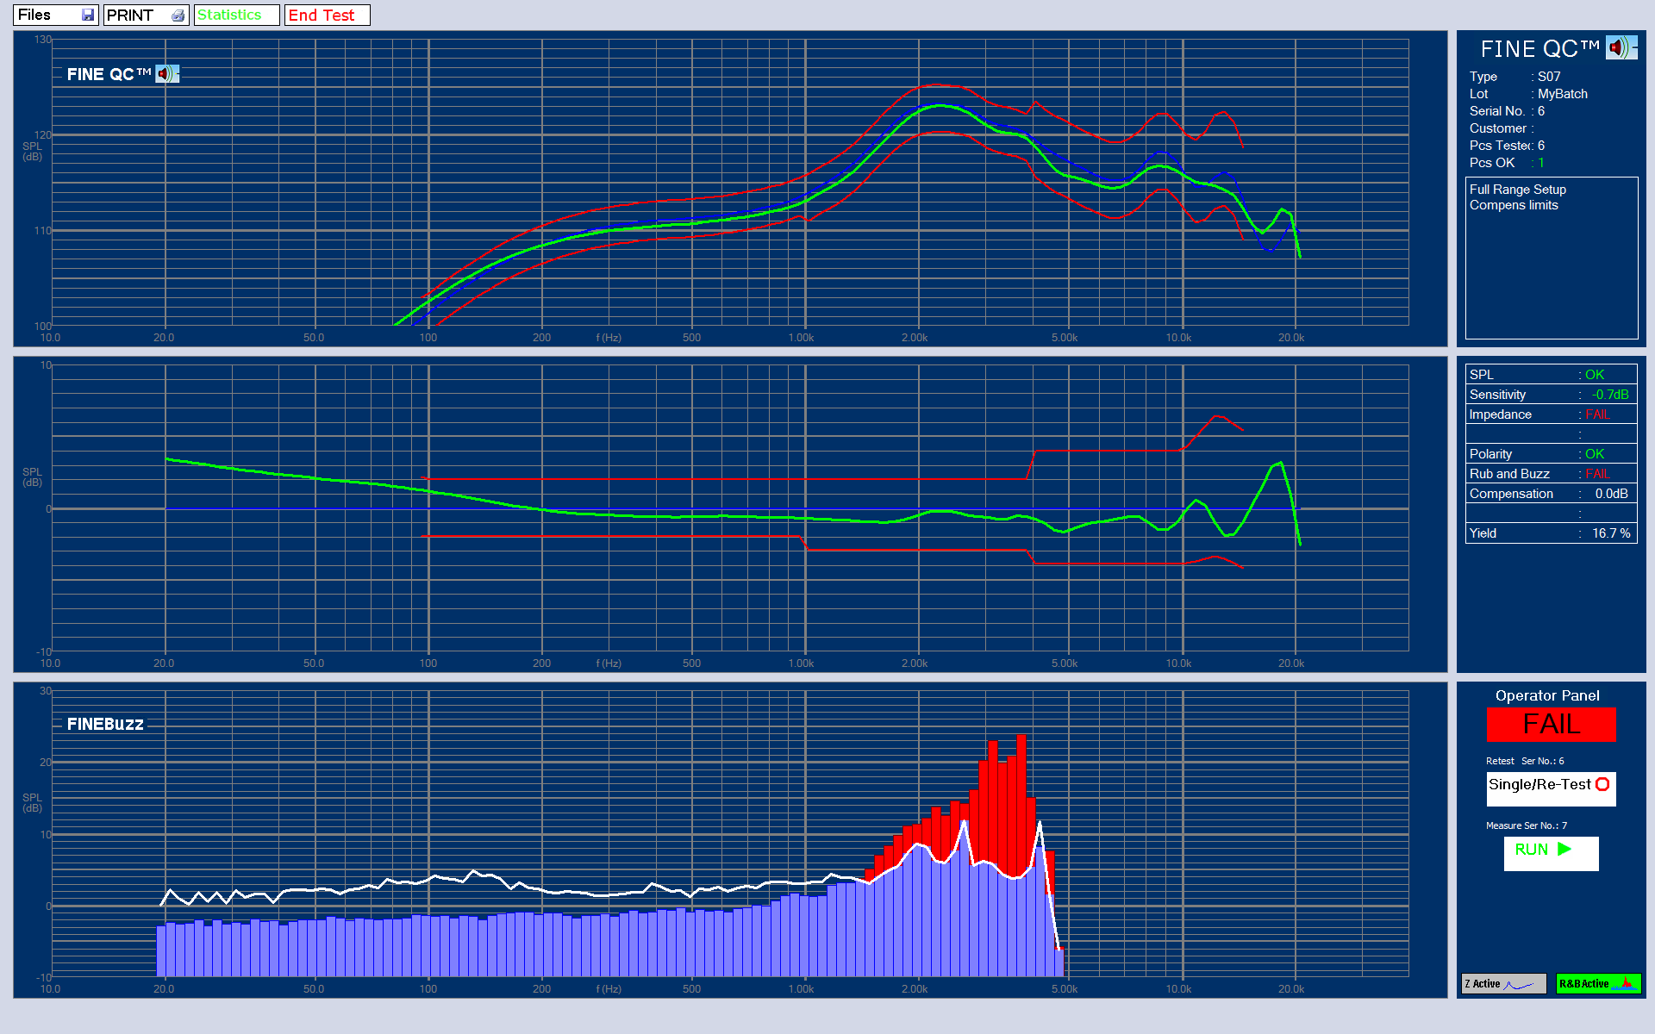
Typical QC Test 典型的QC测试
3in Full Range with Rub & Buzz 1500-5000 Hz.从FINEQC异音模块1500-5000Hz处的3寸全频喇叭的测试曲线见图1

Slide 27
QC Examples from FINE QC / FINEBuzz Plots from QC of 3in speaker with FINE QC.
FINEQC异音模块的3寸全频喇叭的测试曲线
  The upper trace is SPL with tolerances, individually adapted for large peaks/dips.
  Center curve is a comparison with the reference unit, showing the deviation.
  Rub & Buzz is shown as 1/12 octave blue columns. The white line is the limit. Here was excessive Rub & Buzz 1500-5000 Hz. (Red)
In addition the relative sensitivity (average SPL over chosen mid band) is = -0.70dB.
上面的曲线是带公差的频响曲线常被用于适应大的峰谷值，图中中间的曲线是和标准样品比对的差异曲线。
图中最下面的是1/12倍频程的异音曲线，白色是公差曲线。蓝色是合格的部分，超过公差部分会以红色显示，在这个例子当中1500-5000 Hz的部分异音超过了公差限度。
在选择的中频范围内相对灵敏度显示为-0.7 dB。

Slide 28
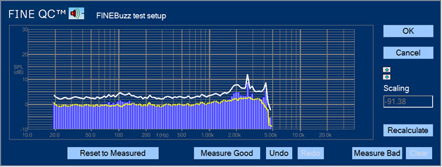
3in Reference driver:
3英寸的样品单体结果，
Rub & Buzz limit (white) including acceptable Rub & Buzz. 0 dB is the Noise Floor (Yellow). Note the -91.38dB Scaling
白色曲线表示可接受的异音上限，黄色曲线表示0dB本底噪声。注意这里检测到了-91.38 dB的微小异音

Slide 29
FINEBuzz Setup for 3in Ref Driver
3英寸异音可以接受的样品单体结果
  The Rub & Buzz (blue columns) uses an advanced scientific algorithm derived through 40 years loudspeaker experience. The yellow dashed line shows the noise floor of the system which is around 0 dB.
The (-91.38 dB) scaling of the Rub & Buzz curve, means that the 0 dB level is close to 90 dB below the signal (scaling is not absolute and depends on other factors)
异音的检测是融合了40年的扬声器的经验并采用先进科学算法，合格的部分显示为蓝色。黄色虚线显示了系统的底噪，在0 dB左右。
总异音曲线显示-91.38 dB，是指异音小于信号90 dB左右，这个数值并不是绝对的，还与其它的一些因素有关。

Slide 30
FINEBuzz Setup for 3in Ref Driver3英寸异音样品设定的单体结果
  The Rub & Buzz limit is set by first measuring some units with acceptable Rub & Buzz (Good) and some that should be rejected (Bad).
  Note that the Rub & Buzz limit includes some peaks at 3.5k and 4 kHz. That indicates that the reference unit is not perfect, but just having acceptable Rub & Buzz.
异音的公差是在第一次设定时由异音合格的和不合格的喇叭单体来设定的。
注意异音显示在3.5-4 KHZ有一些峰值，说明样品并不是完美的，有一些可接受的异音。

Slide 31
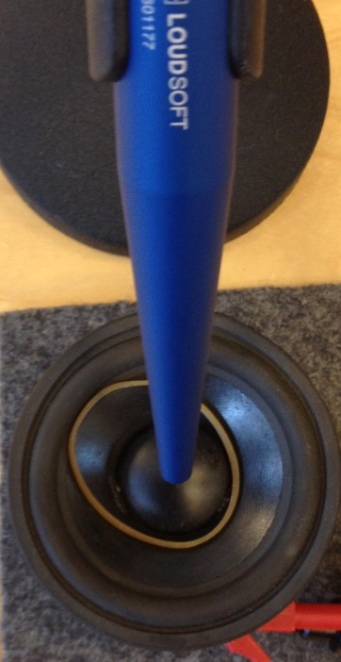
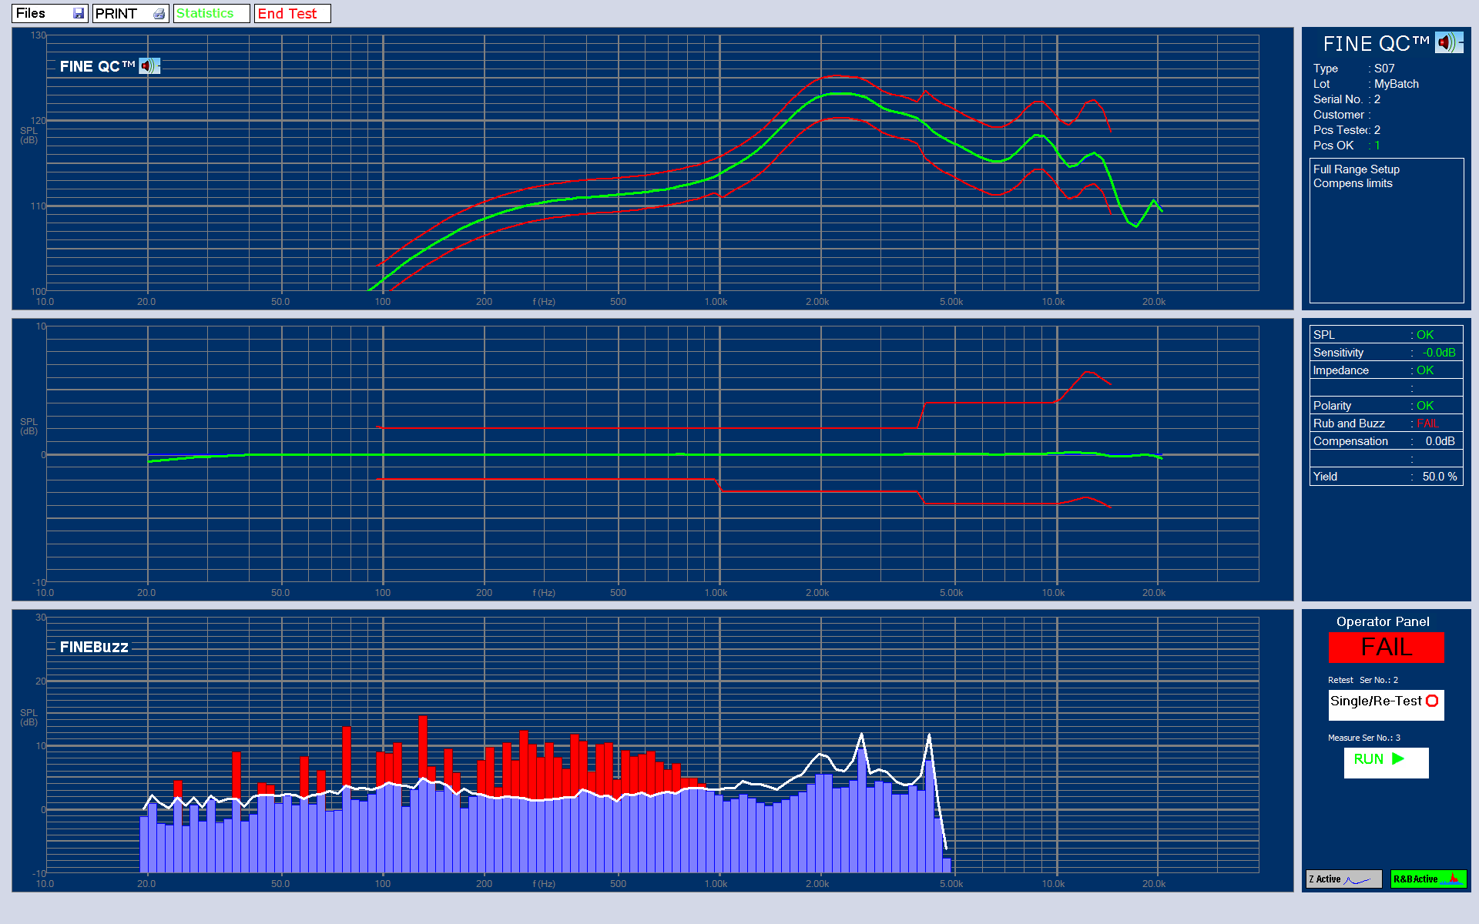
Extremely sensitive FINEBuzz method
The 3in with very gentle buzzing from a soft rubber band resting on the cone
图3显示了异音的算法非常灵敏，把一小片非常软的橡胶放在纸盆上产生了非常微小的扰动杂音，在异音曲线上显示为红色。

Slide 32
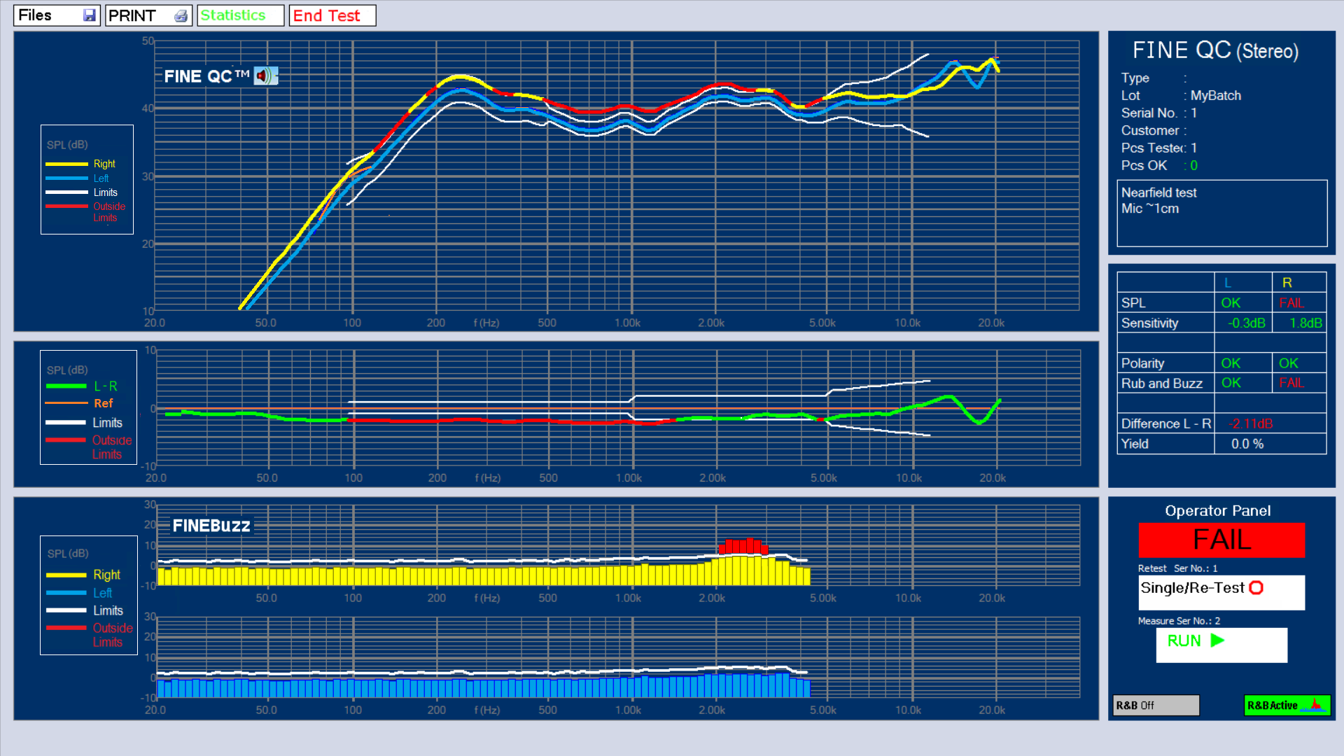
FINE QC Headphone Left + Right
FINEQC耳机左右声道
Headphone with Rub & Buzz QC for both
L and R channels. R has failing Rub & Buzz下图是一个耳机的左右声道的产线异音测试，显示右声道异音已经超过了公差。
(Red)

Slide 33
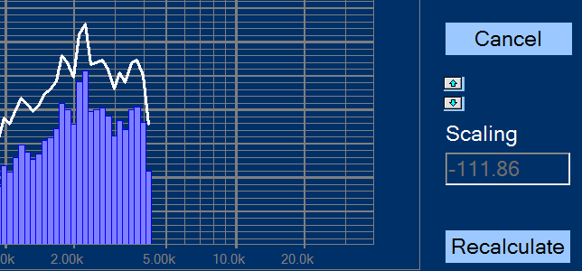
Headphone L / R Test
Rub & Buzz limit (white) including acceptable Rub & Buzz. 0 dB is the Noise Floor (Yellow). Note the -111.86 dB Scaling
白色曲线表示可接受的异音上限，黄色曲线表示0dB本底噪声。注意这里检测到了- 111.86 dB的微小异音

Slide 34
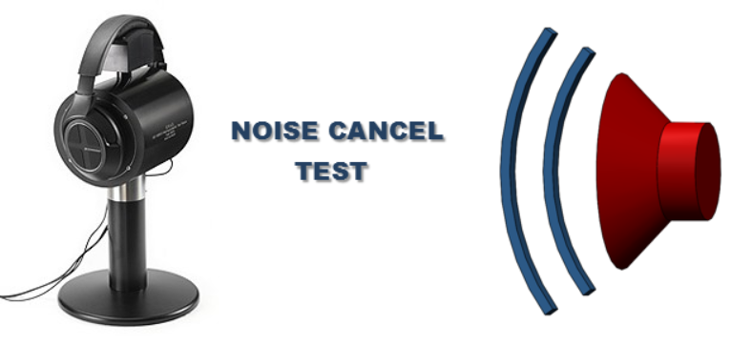
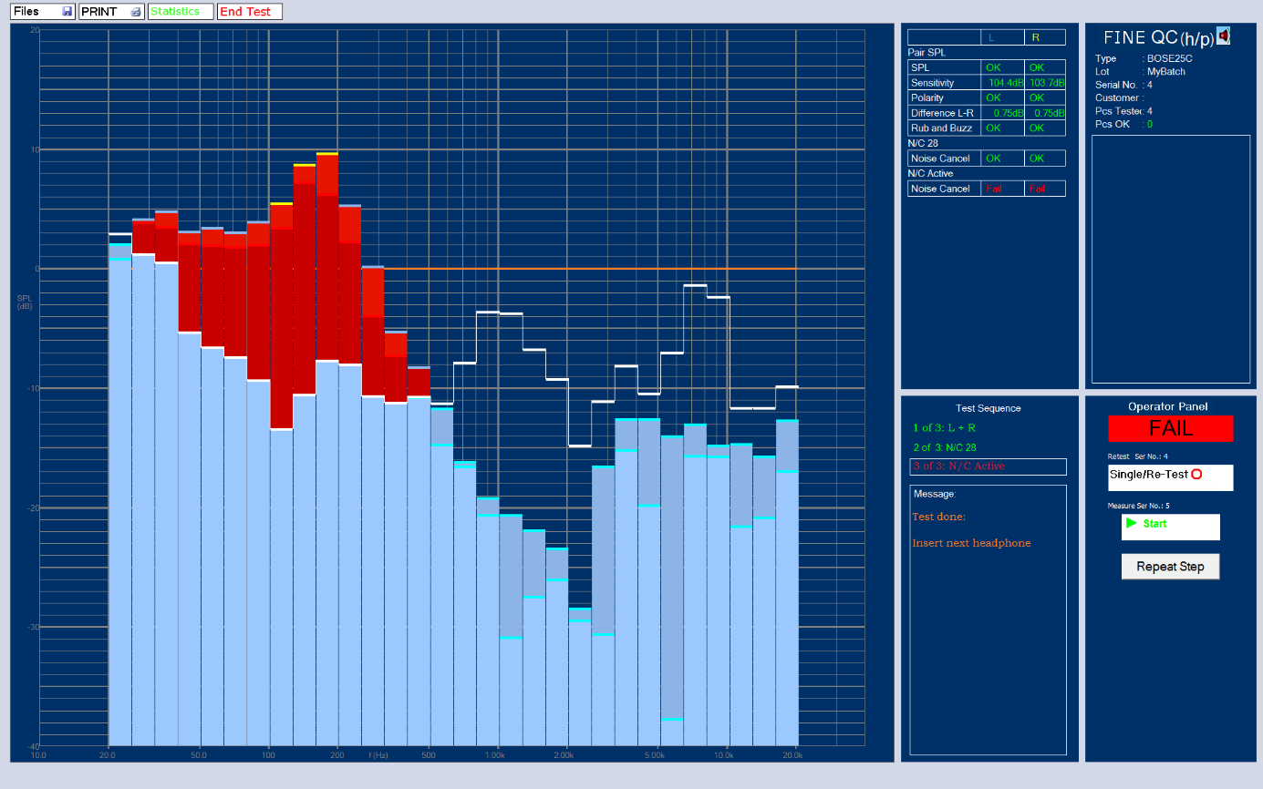
Headphone L / R Noise Cancel Test

Slide 35
Conclusion结论
  Human testing is no longer the preferred Rub & Buzz method, especially in high speed micro- speaker and headphone production.
  Human testing is becoming a problem due to Max SPL regulations.
Modern Rub & Buzz QC test methods are better and faster in today’s high speed production of speakers and headphones. These are more reliable than human testing.
人耳听音检测异音尤其是对高速的微型扬声器产线不再是好的方法。
人耳听音测试由于最大音压的限制会不理想。
在高效率的扬声器尤其是微型扬声器的在线检测，采用现代的异音算法可以更好地更快地测试，比人耳听音测试更可靠。

Slide 36
ALMA 2016:
The end结束
Thank you for listening
感谢聆听.
Peter Larsen

