Slide 1


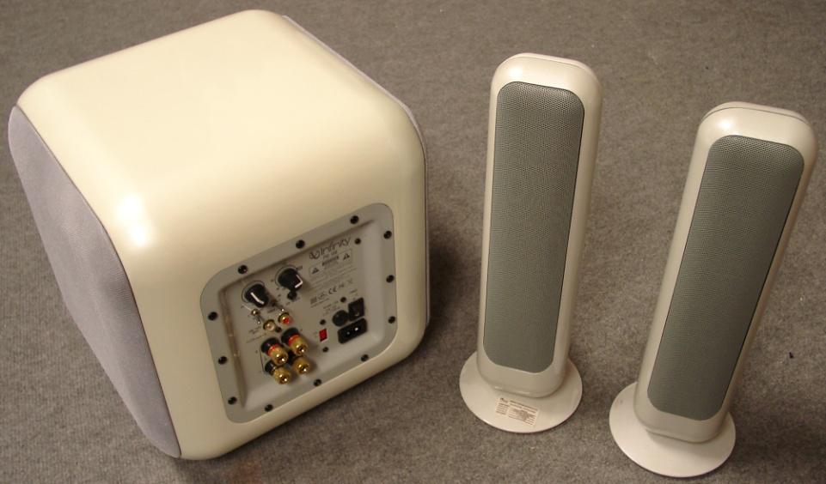
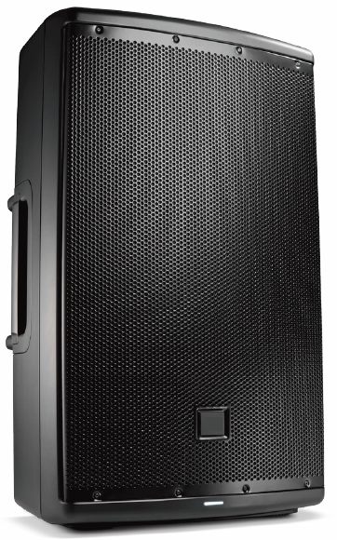
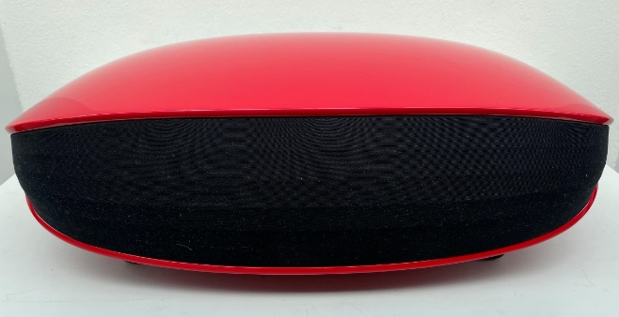
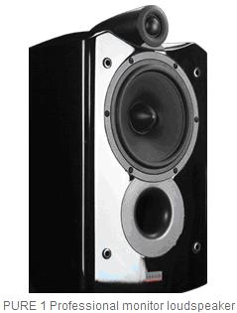
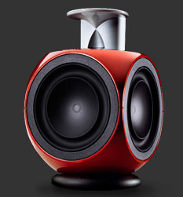
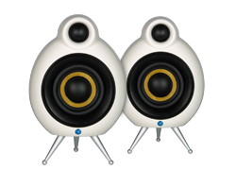
Speaker System Projects
Home Speaker for Music 1, China
2.1 Home Theater System for Harman / Infinity
Portable PA with Class D amps + DSP
Beolab 3
PURE Monitor series for Microlab
”by Peter Larsen”
MicroPod for Scandyna

Slide 2
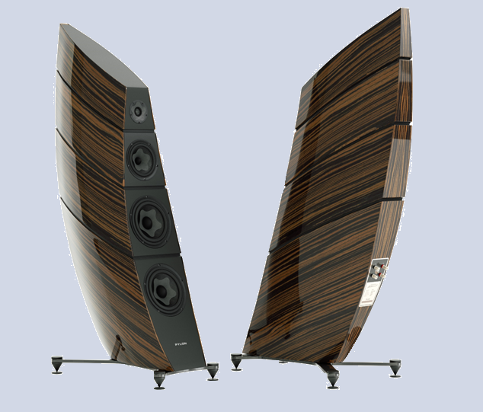
High End Speaker Project
Pylon Audio, Poland

Slide 3
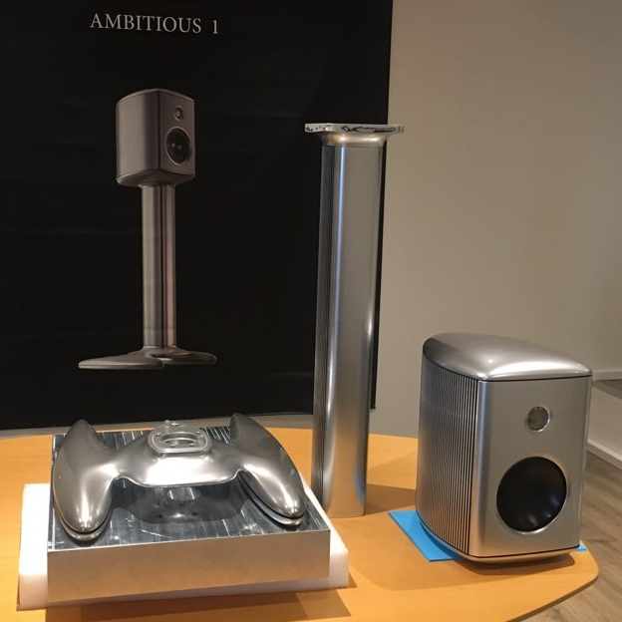
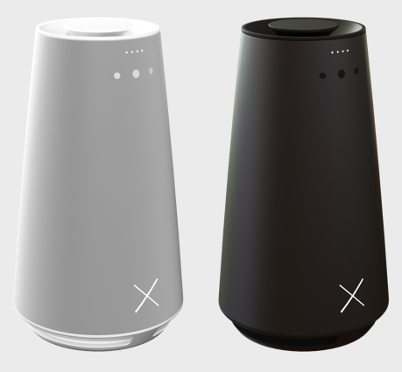
High End Speaker Projects
Kygo Smart Speaker System
Luxury Speaker systems for Ambitious Audio
New Patents for Wire Spider and Subwoofer

Slide 4
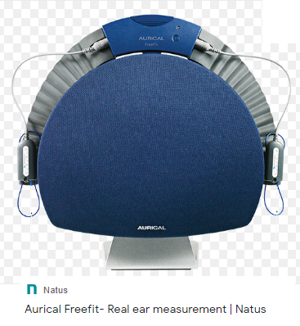
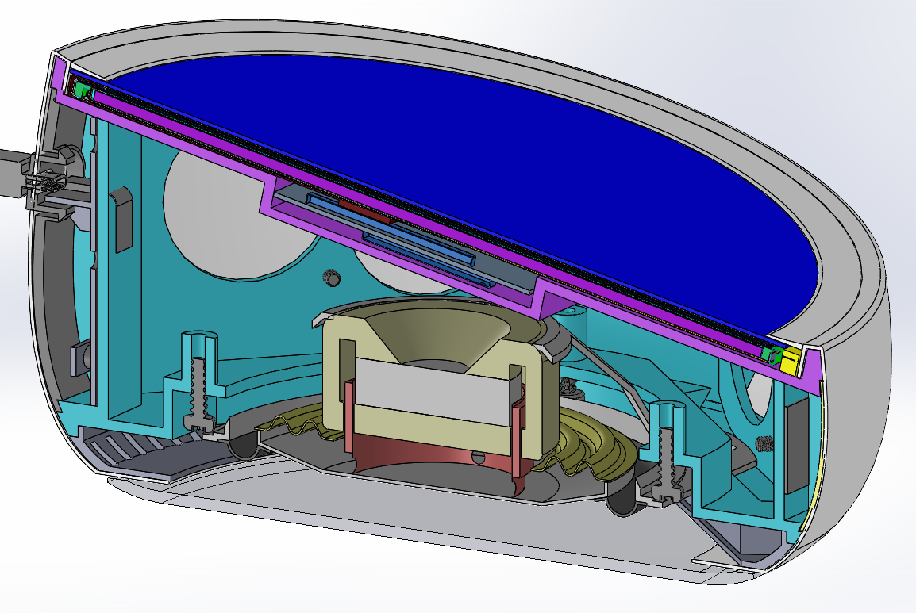
Special Speaker Projects
Conference Speaker for Essential Systems, USA
Test speaker for Hearing Aids Natus, Otometrics

Slide 5
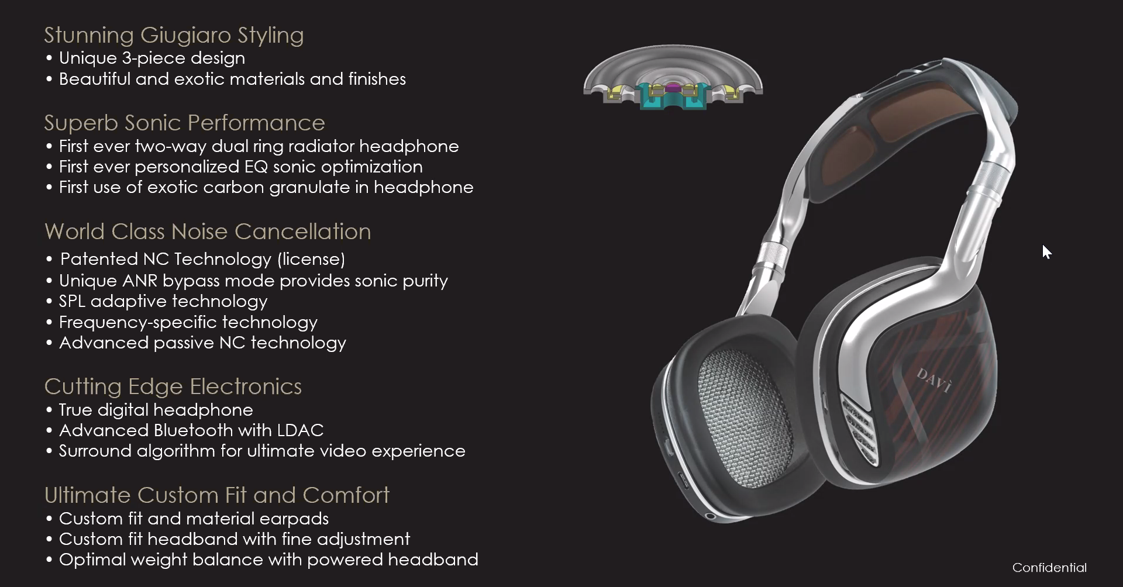
Luxury headphone Project
Davi Audio, USA

Slide 6
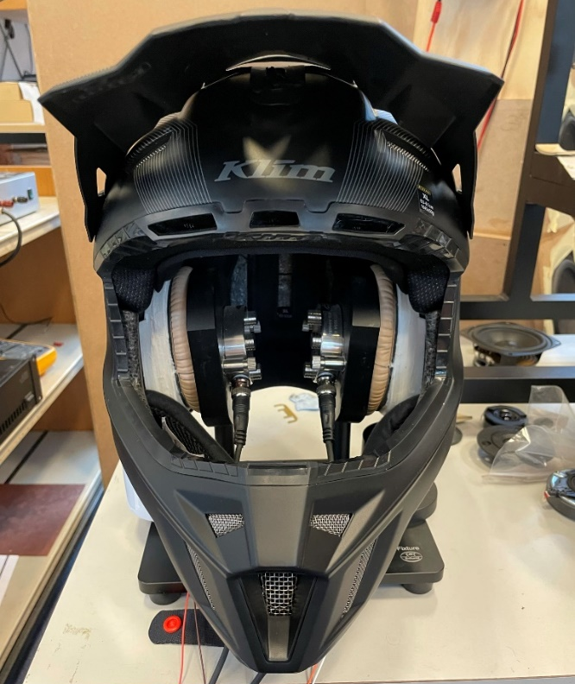
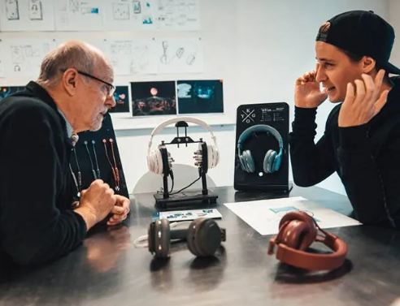
Headphone Projects
Kygo Headphones range A2-A11
Polaris Helmet Headphone Project

Slide 7
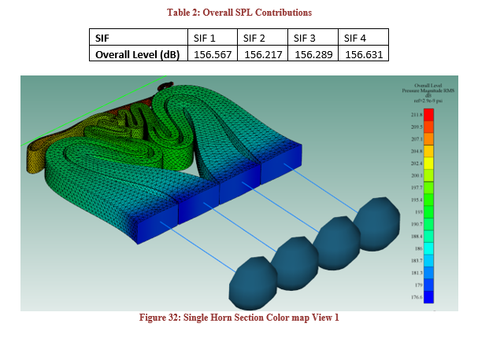
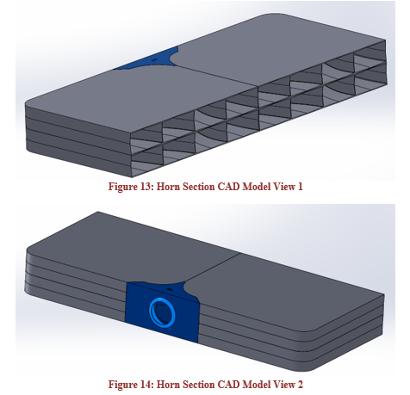
US Navy: Warning Speaker System
One of 8 Horn Systems
Horn Channels of ½ Horn, with SPL levels in 1m

Slide 8
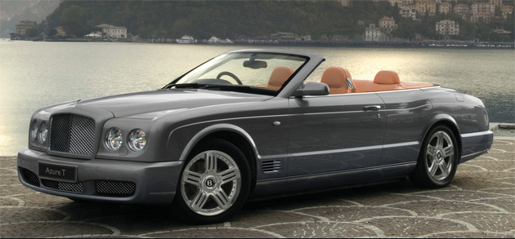
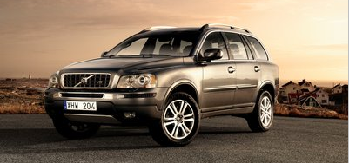
Car Speaker Projects
Bentley GT and Arnage
Speakers Systems
Volvo – XC90 and Premium versions
Dynaudio Speaker System

Slide 9
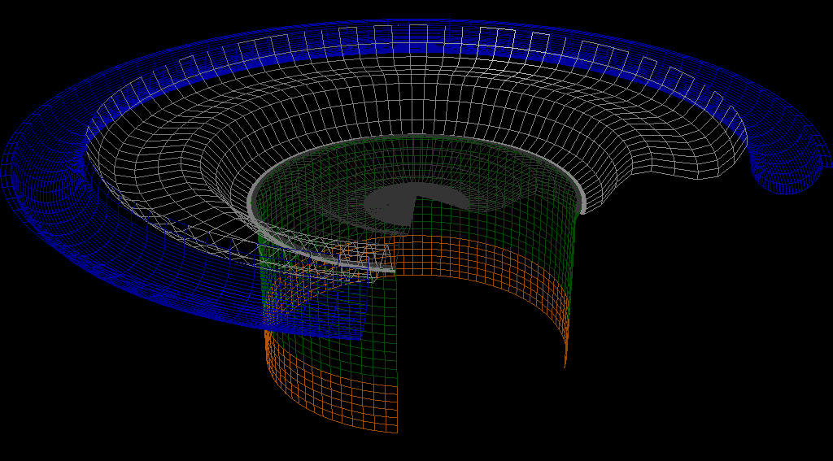
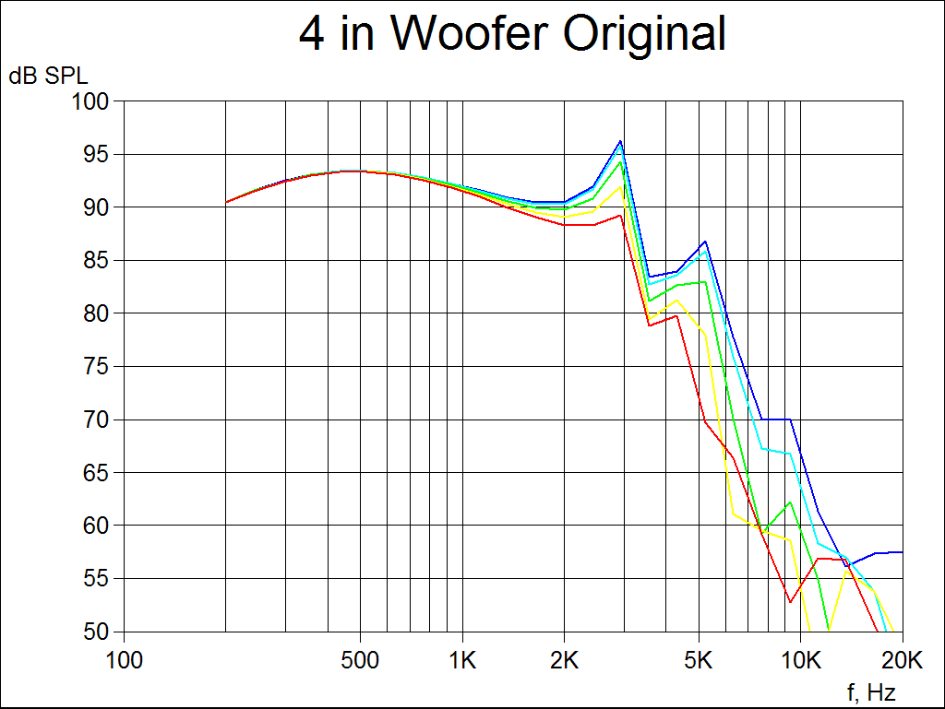
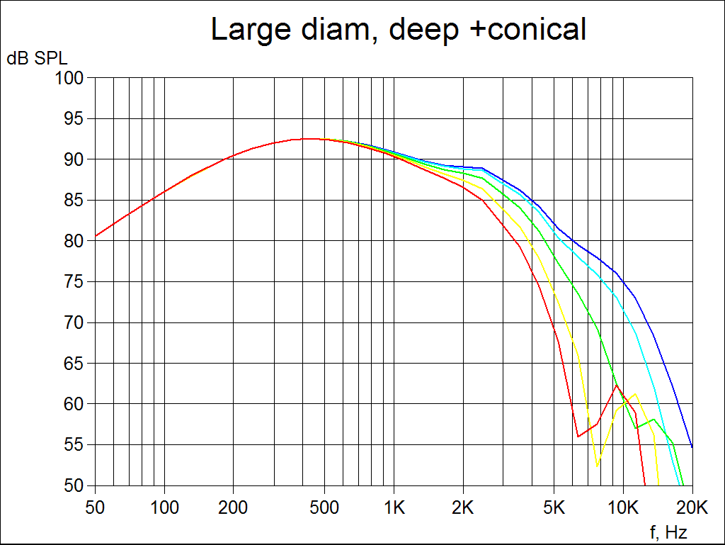
Case Story: Bang & Olufsen (B&O) Cone Design
In 2003 Bang & Olufsen (B&O) Denmark developed a new special loudspeaker design.
The supplier could see this design would cause a poor performance. B&O only replied: Prove it!
To prove it in those days, the supplier had to manufacture a tool – which they knew would not work – at the price of more than 30,000 US$ and 8 weeks of tooling time.
The supplier then asked Peter Larsen from LOUDSOFT to help.
Within 4 hours with FINECone he proved the cone would give a poor sound quality and after 4 more hours he changed the design fulfilling the design ambitions of B&O and at the same time giving a good performance.
That speaker was named Beolab 3.

Slide 10
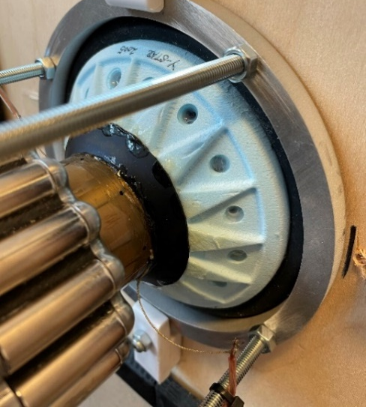
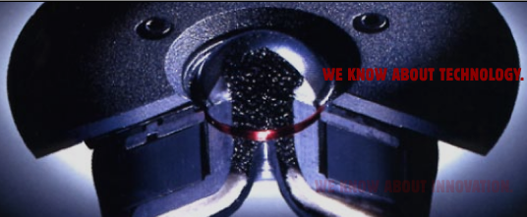
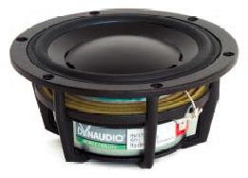
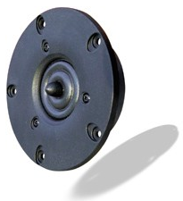
Drivers developed by Peter Larsen
Vifa-Speak Ring Radiator: R25TG
Patent Speaker Cone
Dynaudio Esotech D260 Dome tweeter.
Dynaudio Woofers 15W75 and 20W75.
Alu frame, 3in Voice Coil. Inside magnets

